Slide 1
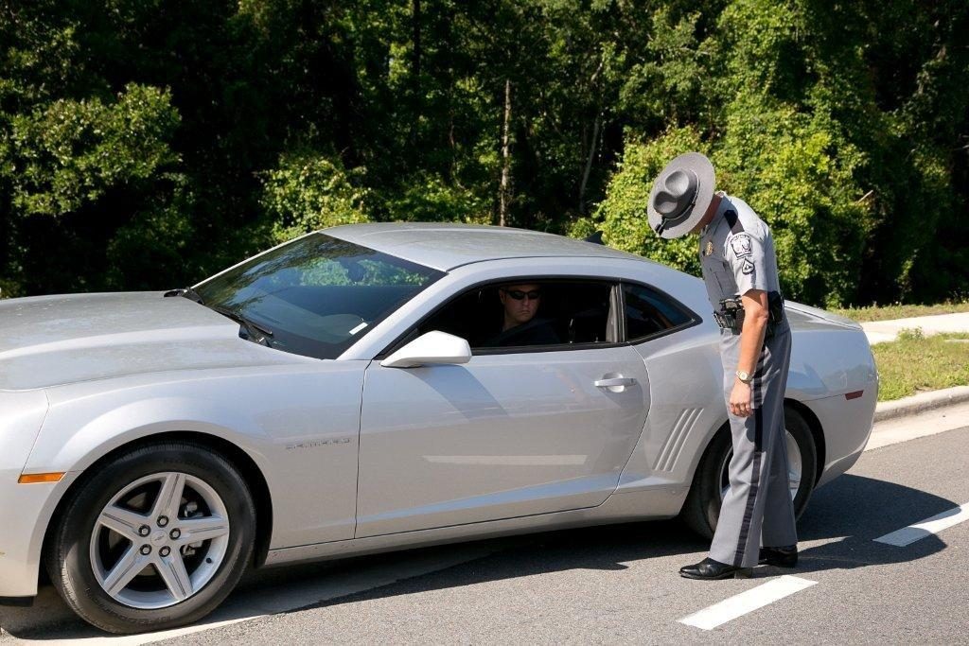



Session 2
Detection and
General Deterrence

Slide 2

Learning Objectives
Describe frequency of DWI violations and crashes
Define general deterrence
Describe relationship between detection and general deterrence
Describe a brief overview of alcohol
Identify common types of alcohol
  Describe physiological processes
  of absorption, distribution, and elimination of alcohol in the body

Slide 3
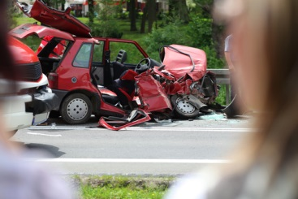
The DWI Problem
Prior to 1994, nearly
50% of total traffic crashes were alcohol-related
10,598 alcohol-related fatalities represented 30% of all traffic fatalities (2020)

Slide 4
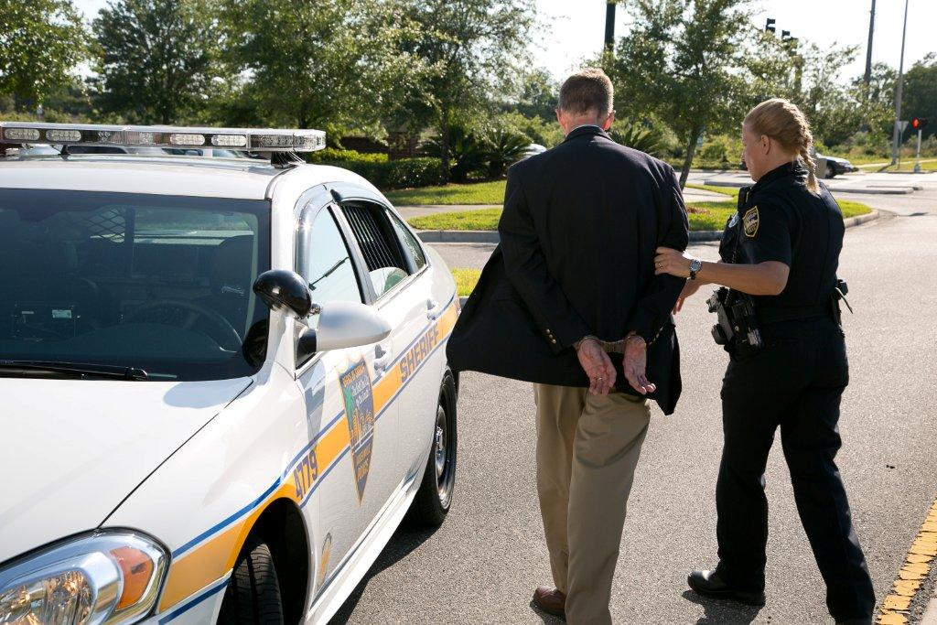
The Local DWI Problem

Slide 5
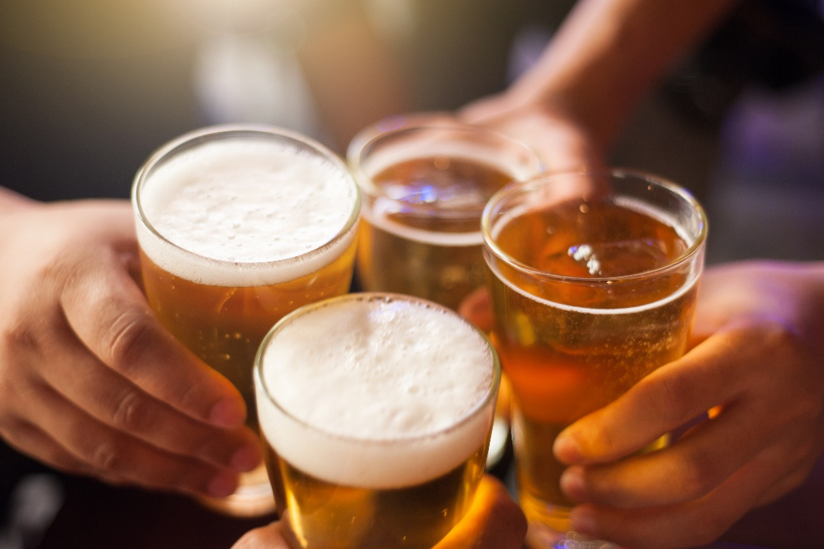
Binge and Heavy Drinking
An estimated 61.6 million people self-reported binge drinking in the past 12 months
17.7 million people classify themselves as heavy drinkers

Slide 6
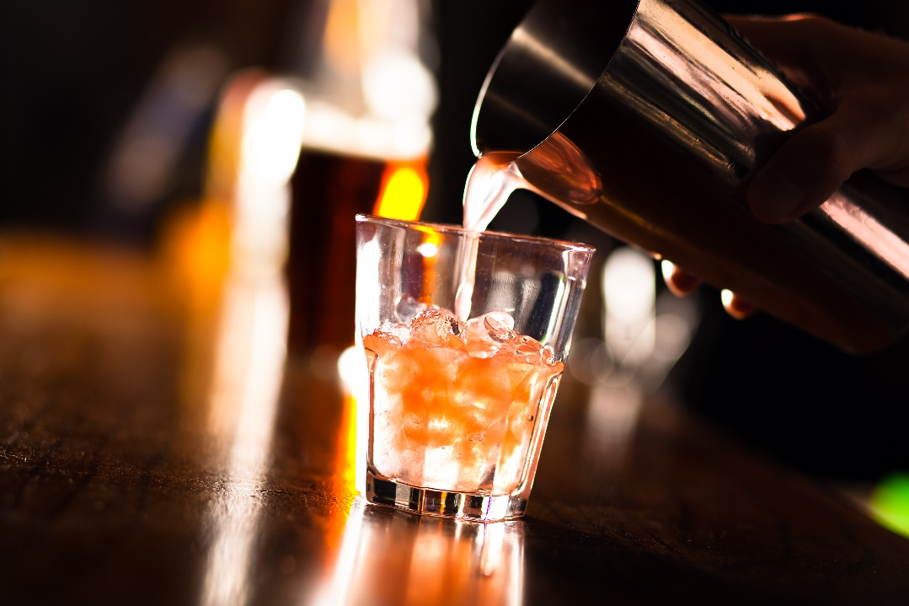
The DWI Problem
What number of drivers commit this violation?
Weekend Nights – 10% or More

Slide 7
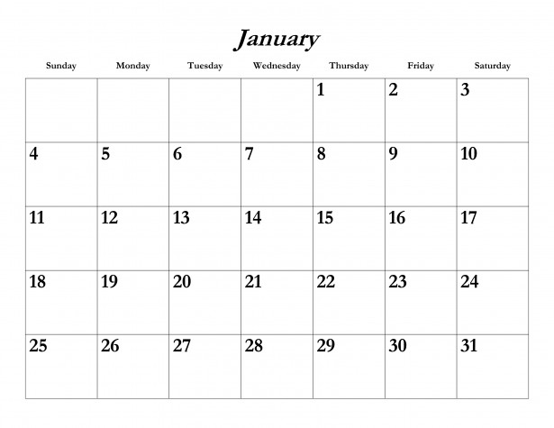
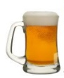
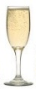
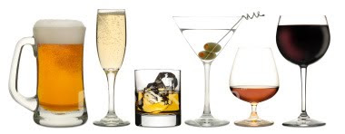


Average DWI Violator
Drives intoxicated 80 times before arrest
Once every four or five nights
Some every day

Slide 8
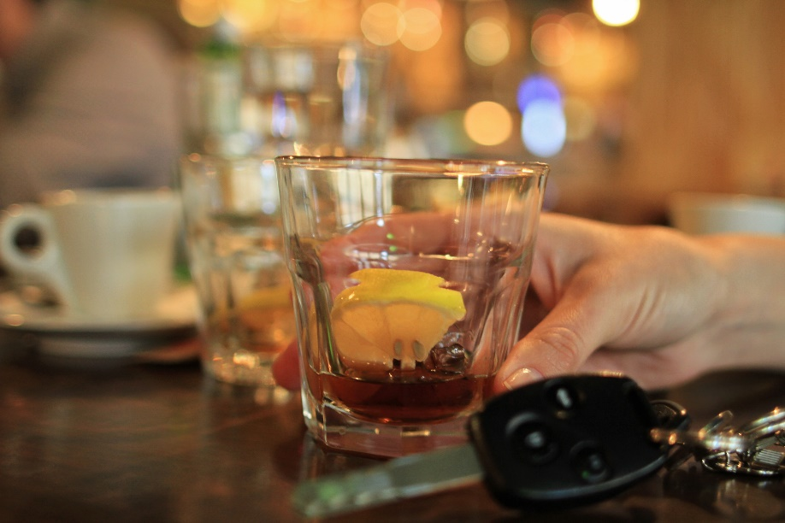
The DWI Problem
Far more than 2% of drivers contribute
Crime committed by a substantial segment of Americans
Can be fought through a societal approach

Slide 9
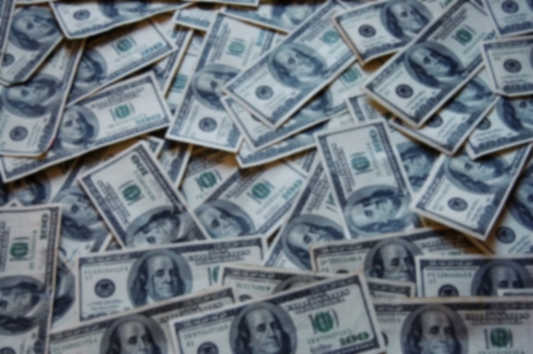
Alcohol-Related Crash Fatalities
26% on weekends were alcohol-impaired
3 times higher at night
1.02 million DWI arrests in 2019
Average one fatality every 52 minutes
Cost society approximately $44 billion

Slide 10
DWI Fatalities

Slide 11
DWI Fatalities

Slide 12
Alcohol Facts (2019)
9,478 lives were lost in speed-related crashes.
Percentage of Alcohol-Impaired Drivers
in Fatal Crashes who were Speeding

Slide 13
Alcohol Facts
3.3x
4x
higher
at night
than
during day
more likely to have prior conviction for DWI

Slide 14


Alcohol Facts
3 male drivers to 1 female driver involved in fatal crashes
4 male alcohol-impaired drivers to female alcohol-impaired driver involved fatal crashes
1

Slide 15
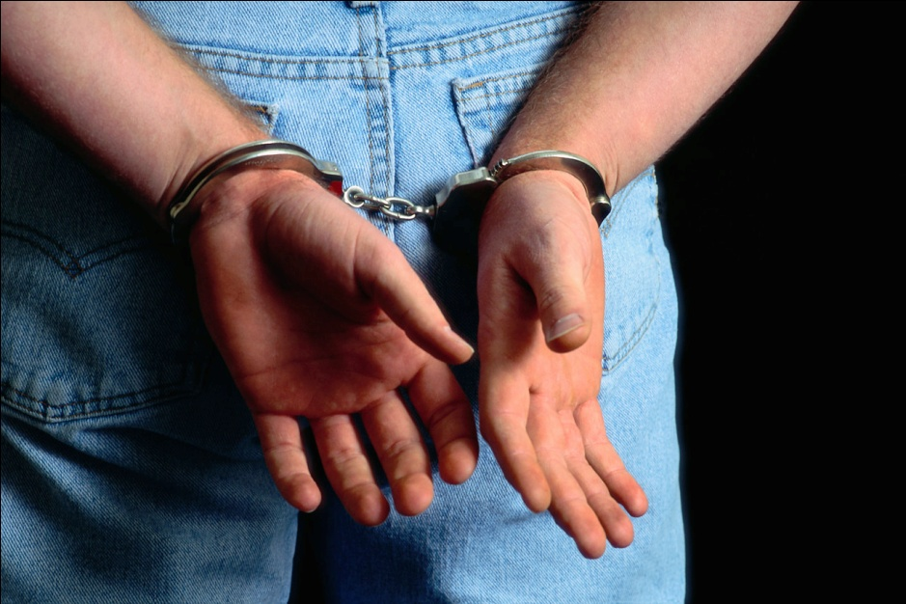
General Deterrence
The fear of arrest

Slide 16
General Deterrence
There is no reason to fear arrest

Slide 17
Fort Lauderdale BAC Study
Citations issued to violators later found to have BACs between 0.10 and 0.20

Slide 18
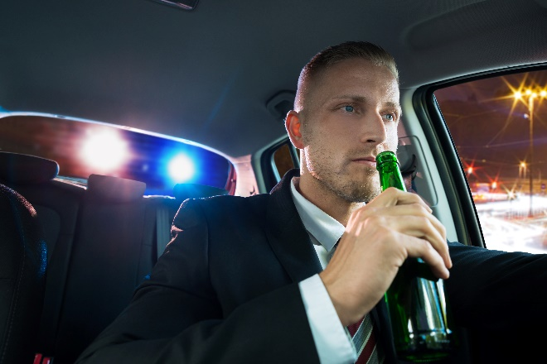
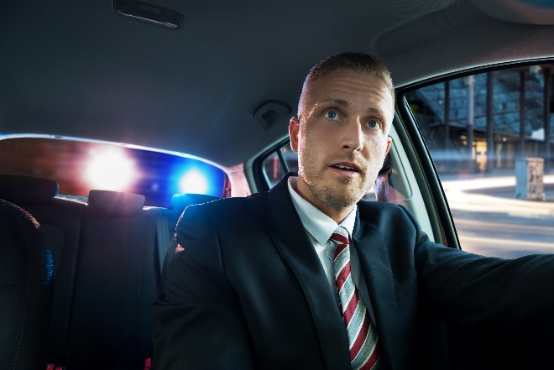
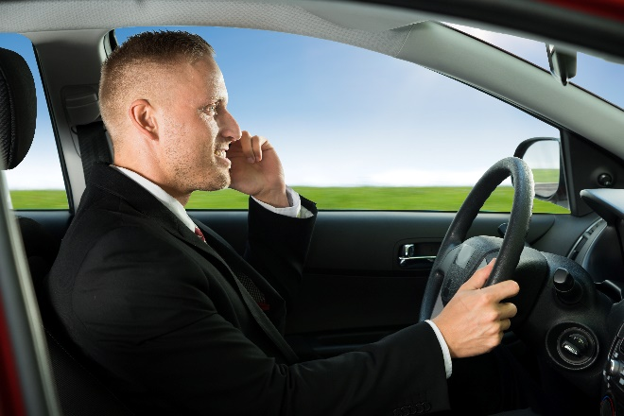
Fort Lauderdale BAC Study
For every DWI violator arrested…
Three others were contacted and released

Slide 19
The Ultimate Goal:
Changing Behavior
Avoid committing DWI
Control drinking prior to driving
Select alternative transportation
Avoid riding with impaired drivers
Recognize impaired driving is unacceptable

Slide 20
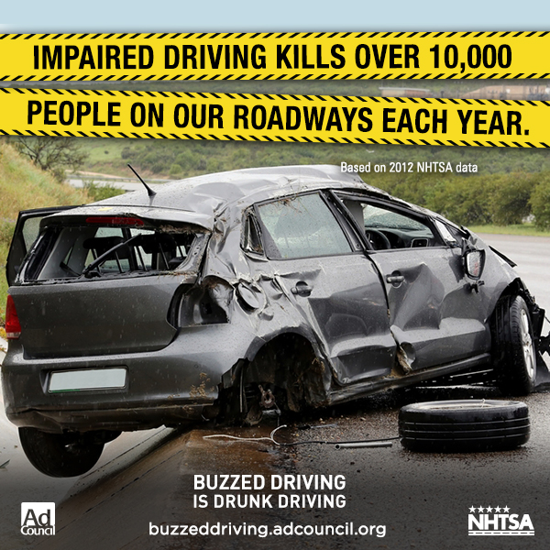
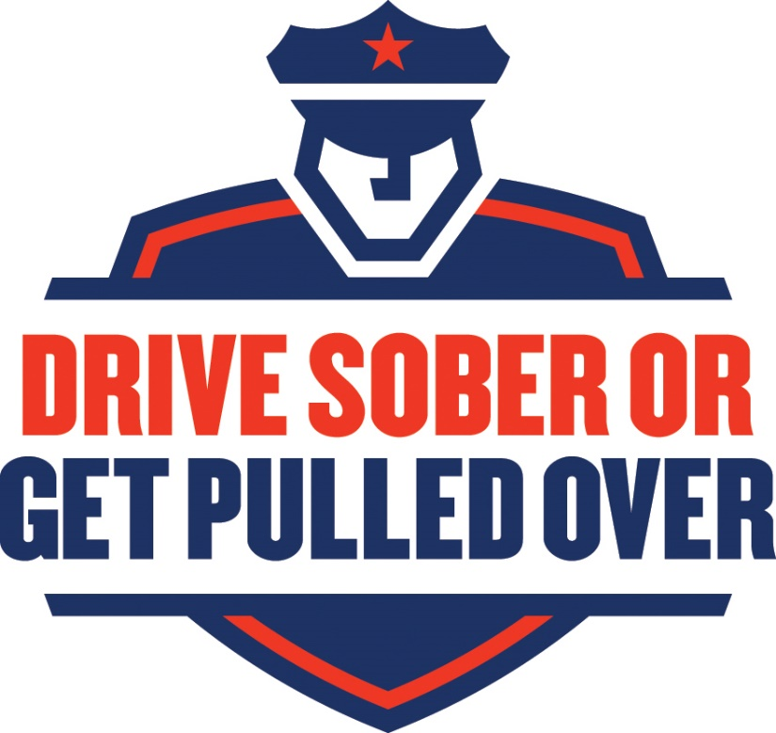
Two Approaches
Prevention
Deterrence

Slide 21

Prevention
Promote positive attitudes
DWI is wrong
No one has the right to endanger others
DWI cannot be tolerated
or condoned

Slide 22

Deterrence
Driving public's fear of being arrested
Enough violators must be arrested to convince public they will get caught

Slide 23
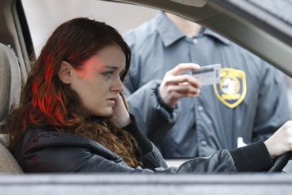
Deterrence
Deterrence is negative reinforcement
Strives to change DWI behavior

Slide 24
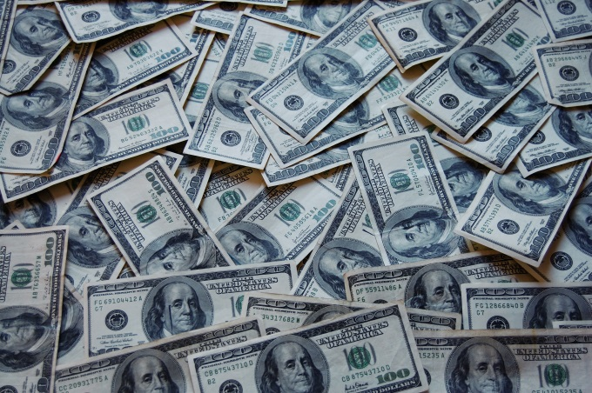
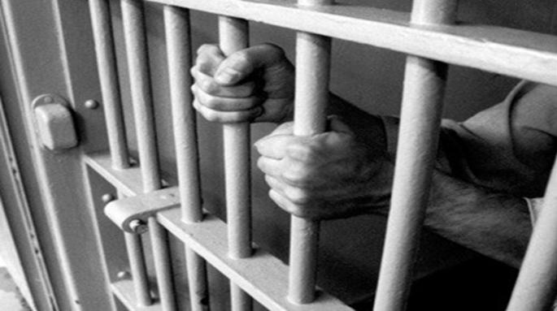
The Fear of Being Caught and Punished
Long term costs and inconvenience

Slide 25
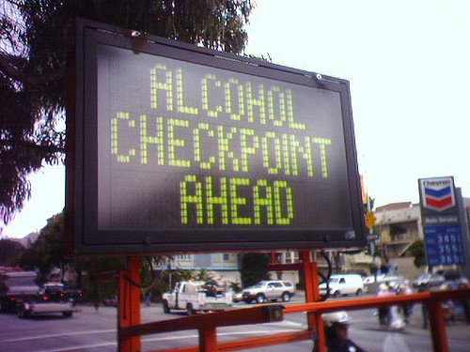
Specific Deterrence
Caught and arrested
Public must perceive appreciable risk of being caught and convicted
Enforcement creates and sustains fear of being caught

Slide 26
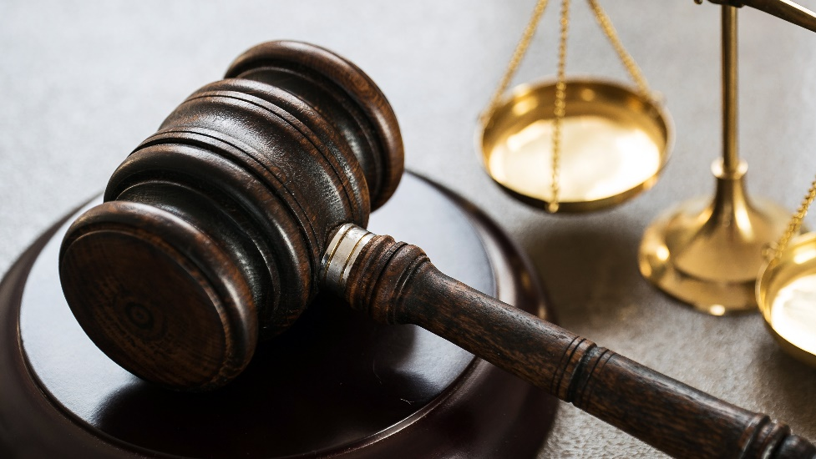

Specific Deterrence
Supportive roles:
Legislators, Prosecutors, Judiciary, Media

Slide 27
How Much Deterrence is Enough?
For every DWI violator arrested, there are approximately 100 undetected DWI violations.

Slide 28
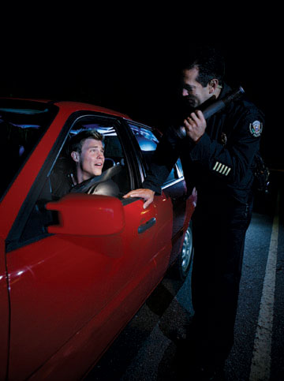
How Great is the Risk?
Does the average DWI violator fear arrest?
Should they be afraid?
Intense publicity may enhance the perceived risk

Slide 29
Changing the Odds
Arrest enough violators to convince many of them it can happen to them
As arrest rate increases, odds are it will happen to them eventually

Slide 30
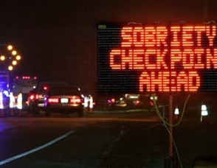
Can it be Done? Will it Work?
Realistic increase in DWI enforcement activity will induce a significant degree of general deterrence and a corresponding change in DWI behavior.

Slide 31
Stockton, California
Before:
  Arrest/violation ratio – 1 in 2000 or less
  Weekend drivers BAC of 0.10 or higher – 9%
During: Intensive DWI enforcement weekend nights
Officers intensively trained, enforcement publicized, justice community coordinated

Slide 32
Stockton, California
Arrests increased 500%
Weekend nighttime crashes decreased 34%
Proportion of nighttime, weekend drivers legally under the influence dropped from 9% to 6%

Slide 33
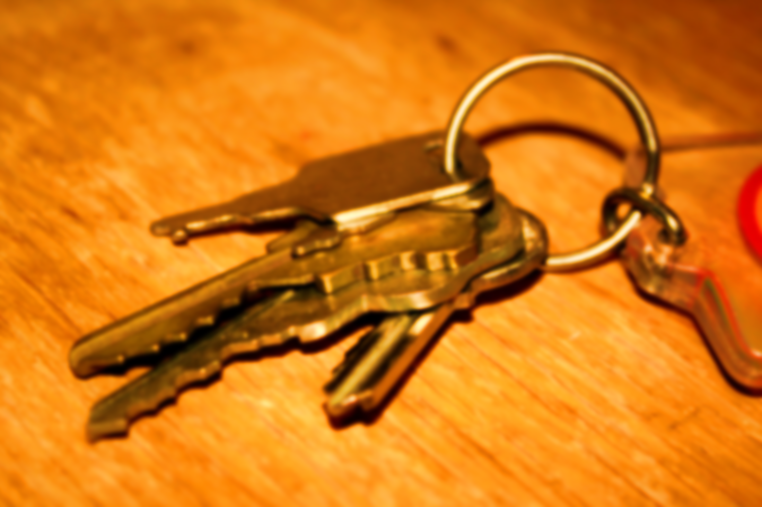
Improve DWI Detection
Keys to success:
Officers skilled at DWI detection
Willing to arrest all violators detected
Policies and application supported by agency

Slide 34
Detection: Key to Deterrence
Deterrence can vastly exceed level of enforcement officers achieve
Weekend DWI arrests can increase by as much as 500%, as in the Stockton study

Slide 35
Example of General Deterrence
When arrest/violation ratio is 1 in 100:
Many violators WILL be caught
General perception level of being caught increases
Behavior changes

Slide 36
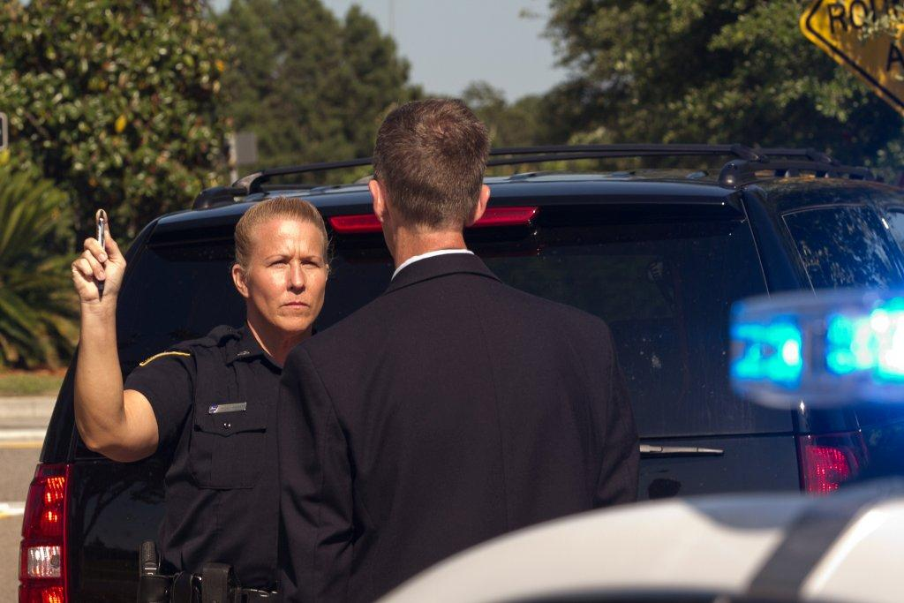
Increased DWI Detection Skills
Community benefits
Officers recognize cues and clues
Gained confidence in field sobriety tests
Fewer violators stopped avoided arrest

Slide 37
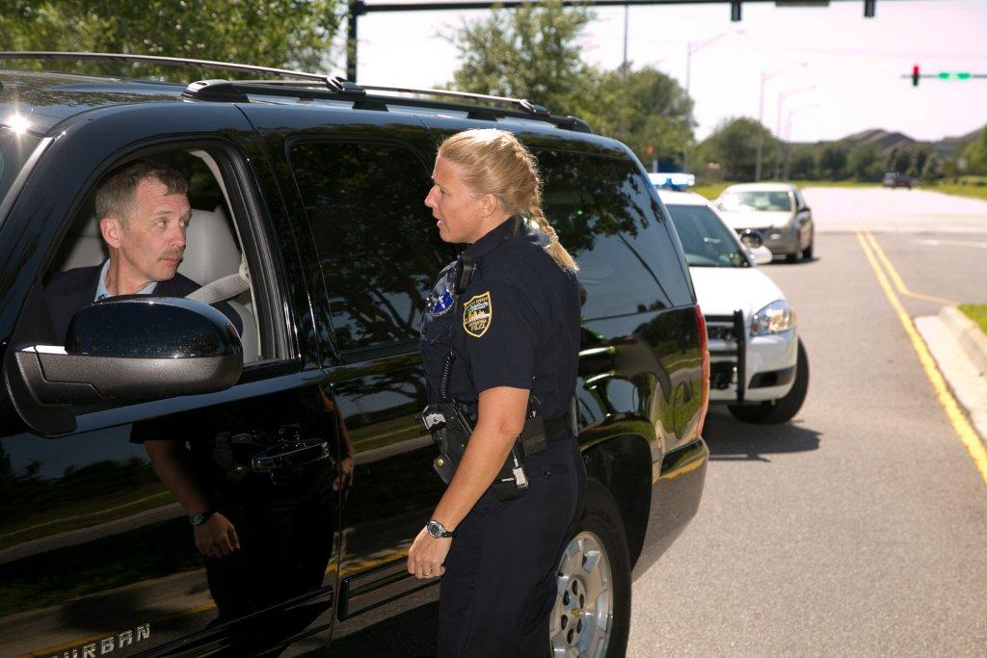
The ability to detect DWI violators is the key to general deterrence and possibly the greatest impediment to it.

Slide 38
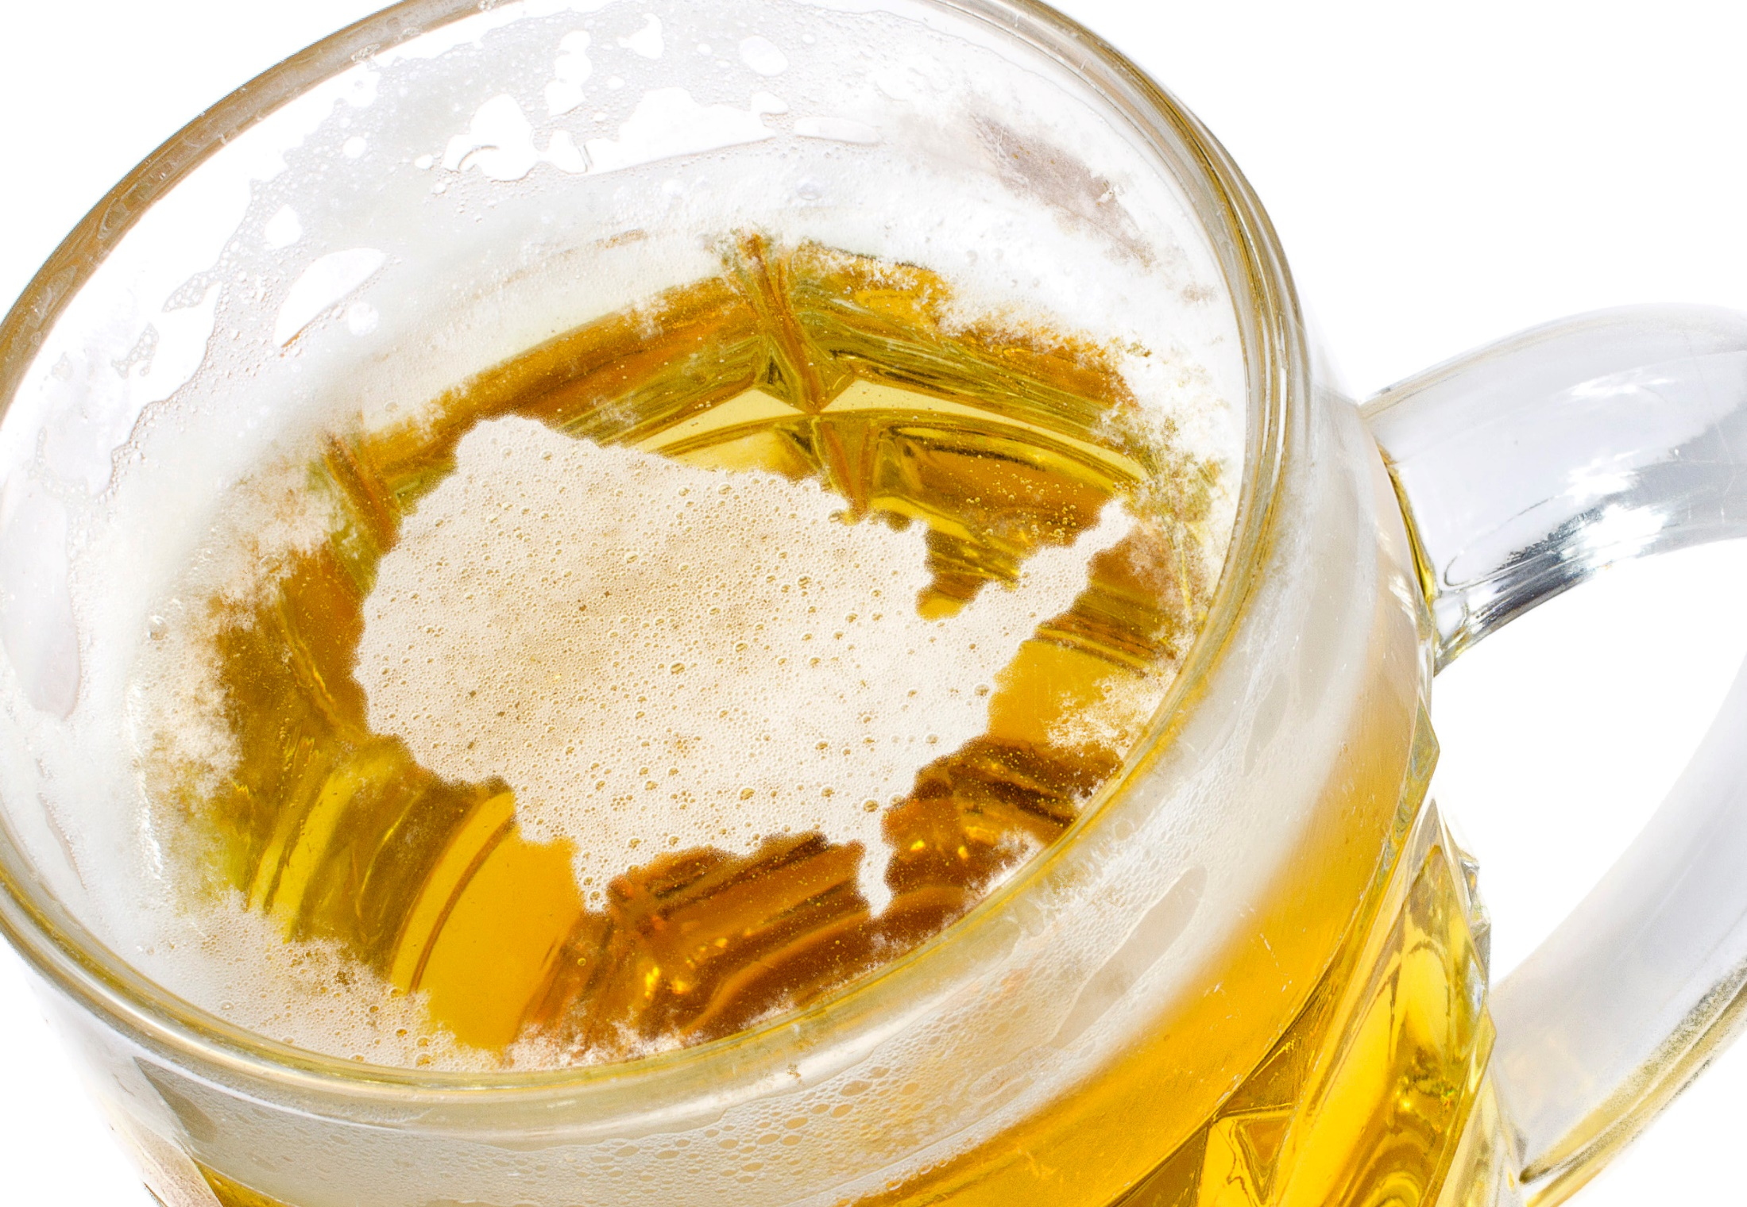
Alcohol is the most abused drug in the United States

Slide 39
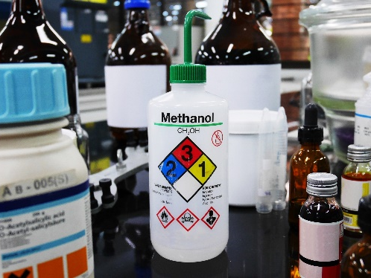
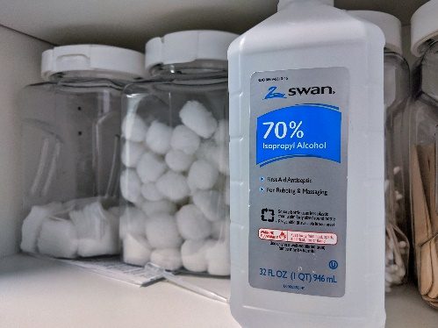
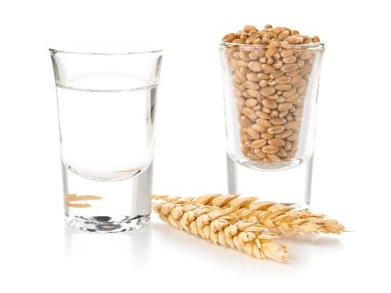
Types of Alcohol
Methyl Alcohol (Methanol)
Isopropyl Alcohol (Isopropanol)
Ethyl Alcohol (Ethanol)

Slide 40
Ethyl Alcohol (Ethanol)
Intended for Human Consumption
Chemical Symbols
  ETOH
  C2H5OH
H H
H C C OH
H H

Slide 41
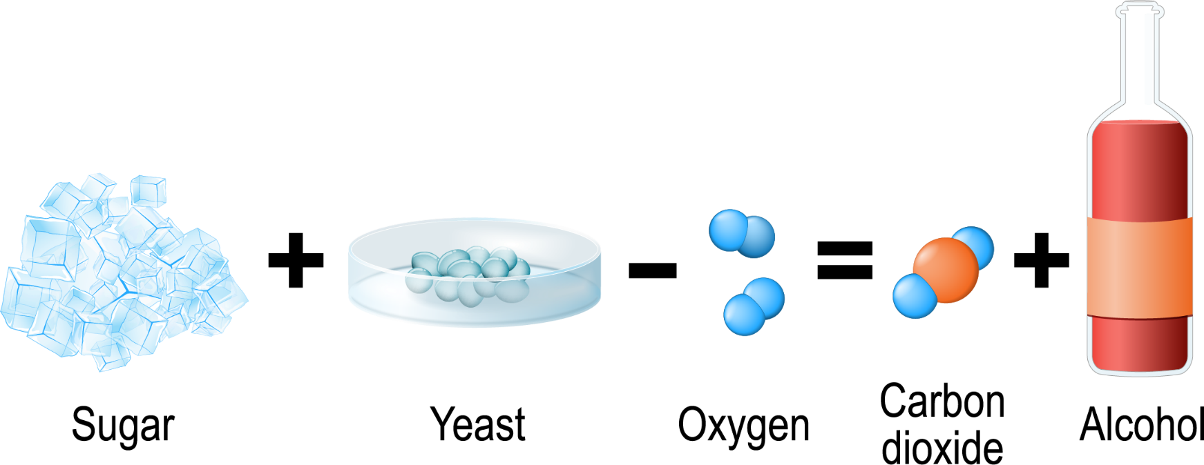
Fermentation
Yeast combines with sugars from fruit or grains in a chemical reaction resulting in ETOH.

Slide 42
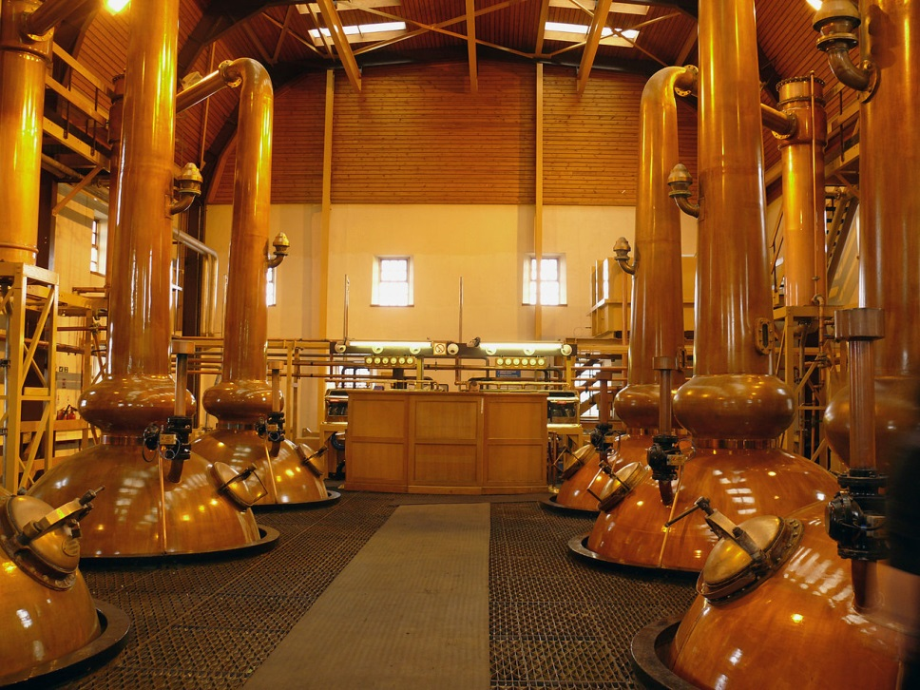
Distillation
Fermented beverage is boiled at a controlled temperature to extract and concentrate the ethanol fumes.

Slide 43
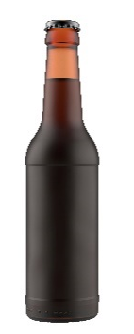
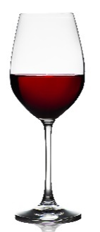

Common Drink Sizes
(0.60 ounces of pure ethanol)
Bottle of beer:
12 ounces of fluid - 5% alcohol
Glass of wine:
5 ounces of fluid - 12% alcohol
Shot of whiskey (80 proof):
1 and 1/2 ounces - 40% alcohol

Slide 44
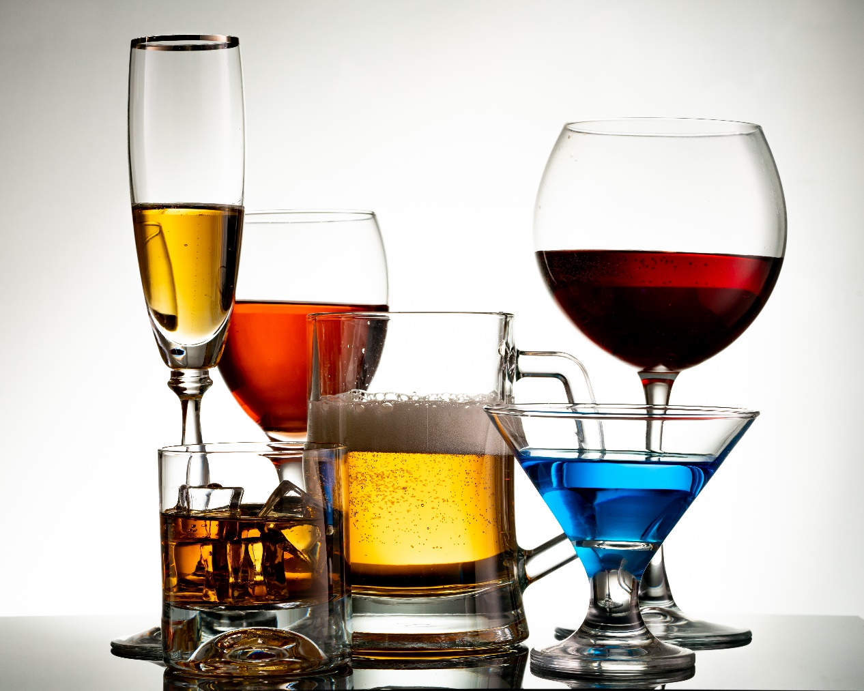
Alcohol is a CNS Depressant

Slide 45
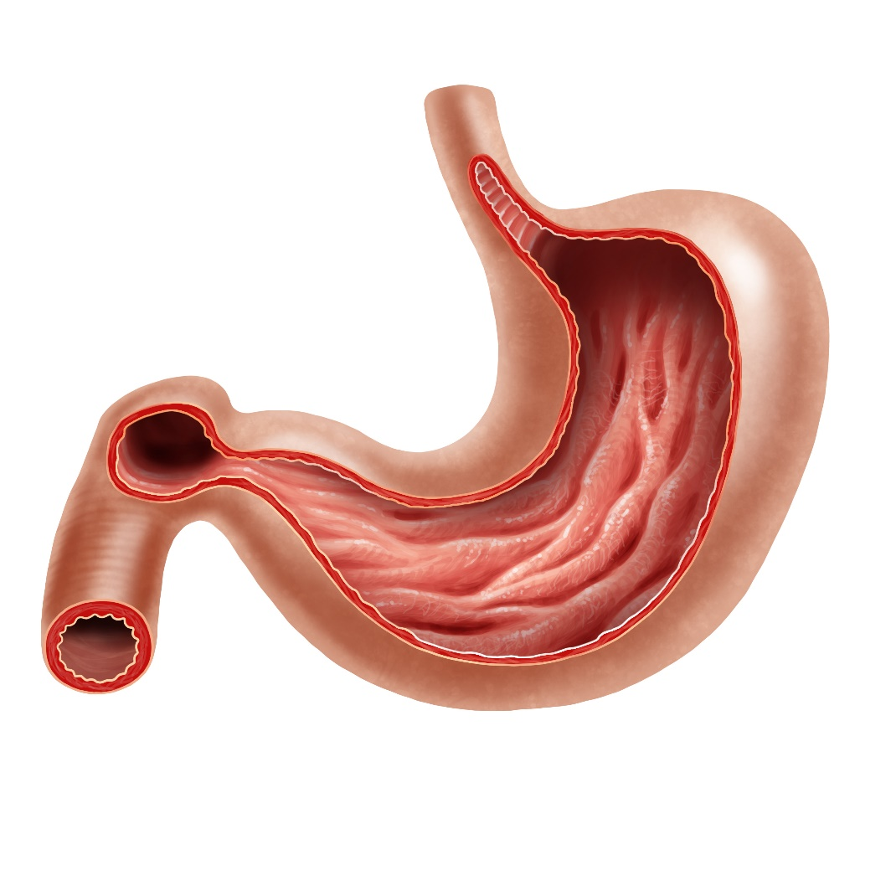
Absorption of Alcohol
Getting the ethanol out of the stomach and into the blood
Esophagus
Stomach
walls
20%
Pylorus
Stomach
walls
80%

Slide 46
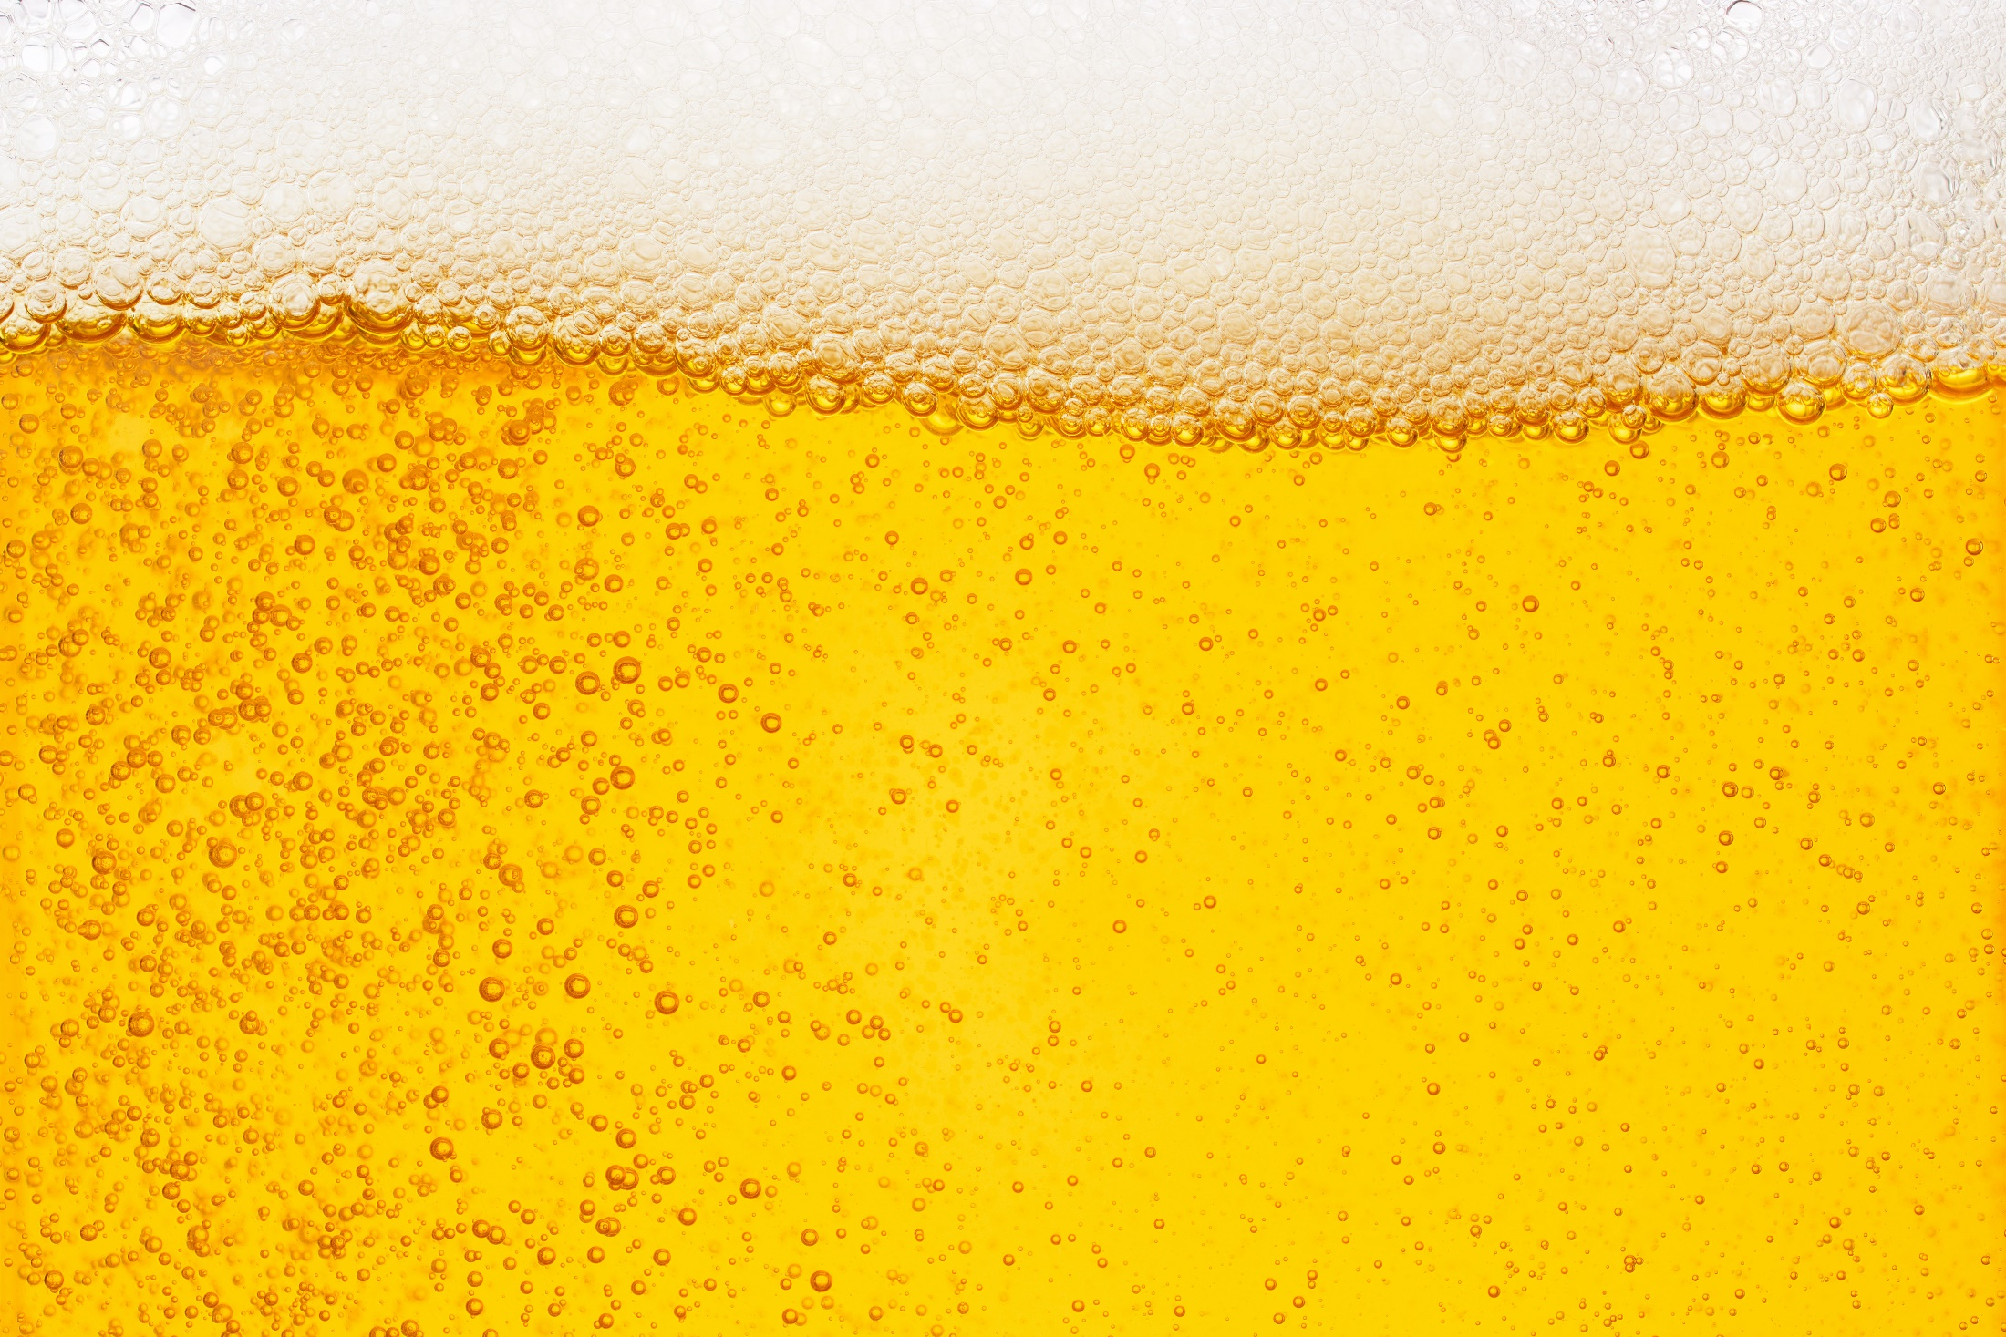
Distribution of Alcohol
Getting the ethanol into the
body’s tissues and organs
Basic Principle
Ethanol goes wherever it finds water

Slide 47
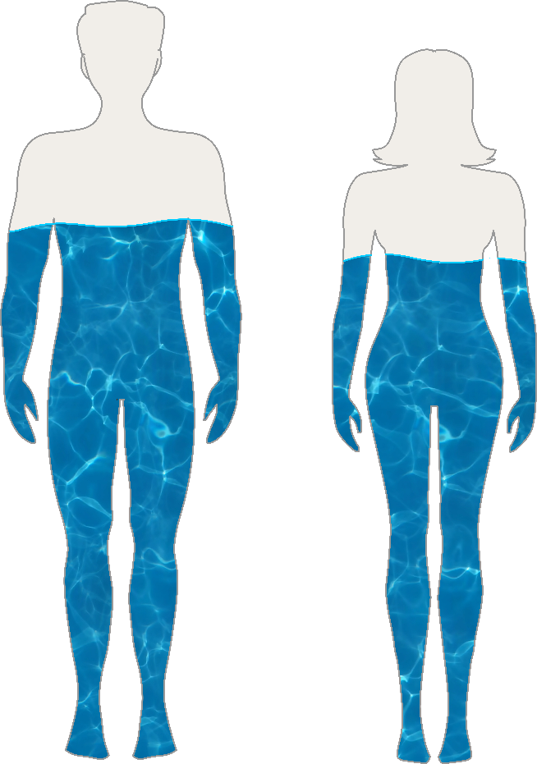
Distribution of Alcohol
Which parts of the body have lots of water?
Which parts do not?
The average male is 68% water
The average female is 55% water

Slide 48
Dose Response Relationships
Time
Sex
Weight
Drinking on empty stomach

Slide 49
Elimination of Alcohol
Direct excretion
  Breath
  Urine
  Sweat
  Tears
  Etc.
Metabolism

Slide 50
Metabolism in the Liver
Burns ethanol
Aided by alcohol dehydrogenase enzyme
Ultimate products of chemical reaction are carbon dioxide and water
Average person’s BAC drops by about 0.015 per hour

Slide 51
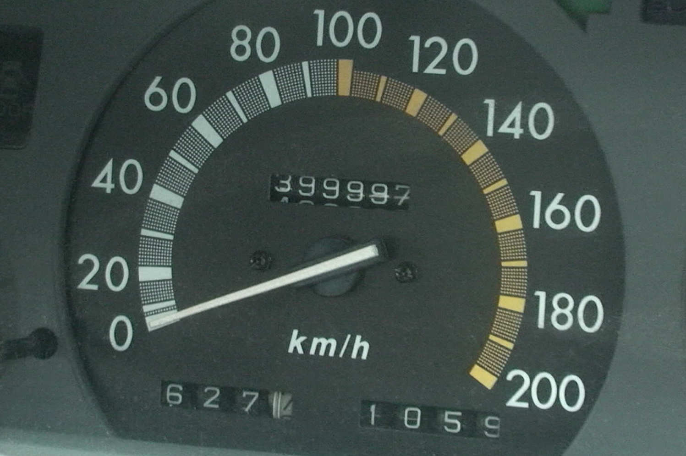
Metabolism
How can we speed up the metabolism of alcohol?
We can't – The liver takes its time burning up the alcohol

Slide 52
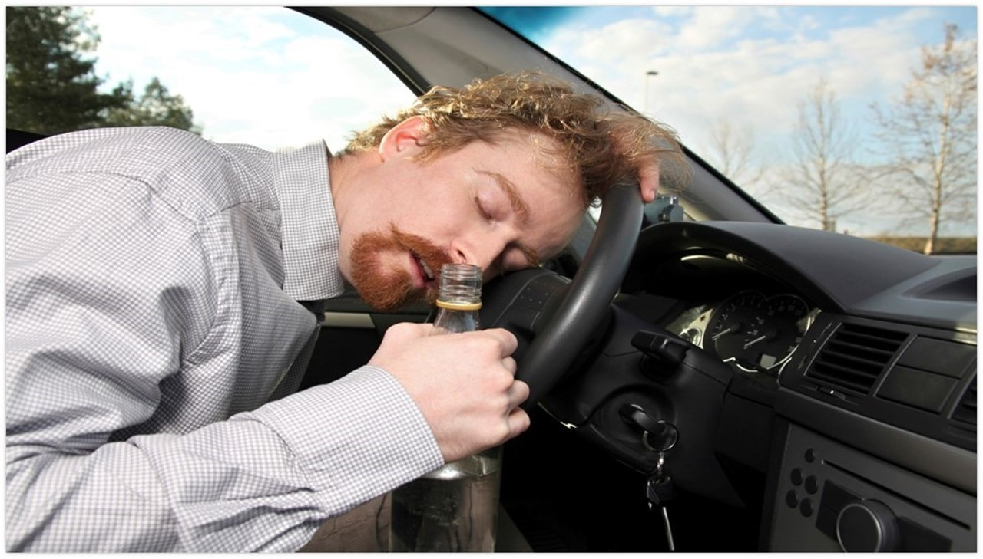
Mellanby Effect

Slide 53
Blood Alcohol Concentration
BAC is the number of grams of alcohol found in 100 milliliters of the person’s blood
  Example: If a person has a BAC of .08, then there is eight one-hundredths of a gram of alcohol in every 100 milliliters of the person’s blood

Slide 54
Questions?

Slide 55
Test Your Knowledge
In typical DWI enforcement, one violator in _____ results in arrest.
In the Fort Lauderdale study, police officers arrested _____ % of the drivers they contacted whose BACs were .10 to .20.
Name three different chemicals that are alcohols.

Slide 56
Test Your Knowledge
Which of these is beverage alcohol, intended for human consumption?
What is the chemical symbol for beverage alcohol?
What is the name of the chemical process by which beverage alcohol is produced naturally?

Slide 57
Test Your Knowledge
What is the name of the process used to produce high concentration beverage alcohol?
True or false: Pound for pound, the average woman contains more water than does the average man
What do we mean by the “proof” of an alcoholic beverage?

Slide 58
Test Your Knowledge
True or false: Most of the alcohol a person drinks is absorbed into the blood via the small intestine
What is the name of the muscle that controls the passage from the stomach to the lower gastrointestinal tract?
True or false: Alcohol can pass directly through the stomach walls and enter the bloodstream.

Slide 59
Test Your Knowledge
In which organ of the body does most of the metabolism of the alcohol take place?
Once a person reaches his or her peak BAC, it will drop at a rate of about _____ per hour.
0.025
0.015
0.010
True or false: It takes about 30 minutes for the average 175-pound man to “burn off” the alcohol in one 12 ounce can of beer.

